Slide 1
COMPLETE HTML COURSE
<p> The Best HTML Course in Entire Internet </p>

Slide 2

COURSE TOPICS
BASICS
ADVANCED
PRO LEVEL
How Website Works?
HTML Document Structure
HTML Tags and Elements
HTML Headings
HTML Paragraphs
HTML Comments
Text Formatting in HTML
Links and Anchors
Images in HTML
Void Elements in HTML
Lists in HTML
Tables in HTML
40+ Interview Questions
30+ Tips & Tricks
Notes + List of Deprecated Tags
50+ Animated Slides
PROJECT –
COMPLETE WEBSITE
USING HTML ONLY +
BASIC OF CSS 💖
HTML Map & Area Elements
HTML IFRAMES
HTML Picture Tag
HTML Figure Tag
HTML Audio TAG
HTML Video TAG
Forms and Input Elements
HTML Semantic Elements
HTML Meta Tags
HTML SEO
Website Ranking Score
Host Website Live For Free & Paid

Slide 3


HOW WEBSITE WORKS?
01

Slide 4





www.thapatechnical.com
HTML
CSS
JAVASCRIPT

Slide 5

BUILDING BLOCKS OF WEBSITE
CSS
JS
HTML
Styles and designs the appearance of the webpage
Adds interactivity and dynamic behavior to the webpage.
Provides the structure and content of a webpage.

Slide 6
REAL LIFE
EXAMPLE

Slide 7
HTML
HyperText MarkupLangauge
<p> Markup Lang. it’s a way to give instructions to a computer about how content should be organized and displayed.</p>
<p> Hypertext is text which contains links to other texts.</p>
<p> This is a <strong>bold</strong> text.</p>

Slide 8
HISTORY OF HTML
HTML5 (2014): HTML5 was a major milestone, with a focus on multimedia, improved semantics, and better support for web applications. It introduced new elements like <video>, <audio>, and <picture>. HTML5 made web development more versatile and capable.
HTML 2.0 (1995),
HTML 3.2 (1997,
& HTML 4.0 (1997-1999
HTML 4 introduced significant improvements, including better support for forms, scripts, and style sheets. It was a crucial step toward modern web development.
Early Beginnings (1980s): The concept of hypertext was proposed by computer scientist Ted Nelson in the 1960s. In the 1980s, Tim Berners-Lee, a British computer scientist, introduced the World Wide Web (WWW) and developed the first HTML

Slide 9


HTML SYNTAX
01
Content
Opening Tag
Closing Tag
<h1>
</h1>
Best HTML Course
HTML Elements

Slide 10
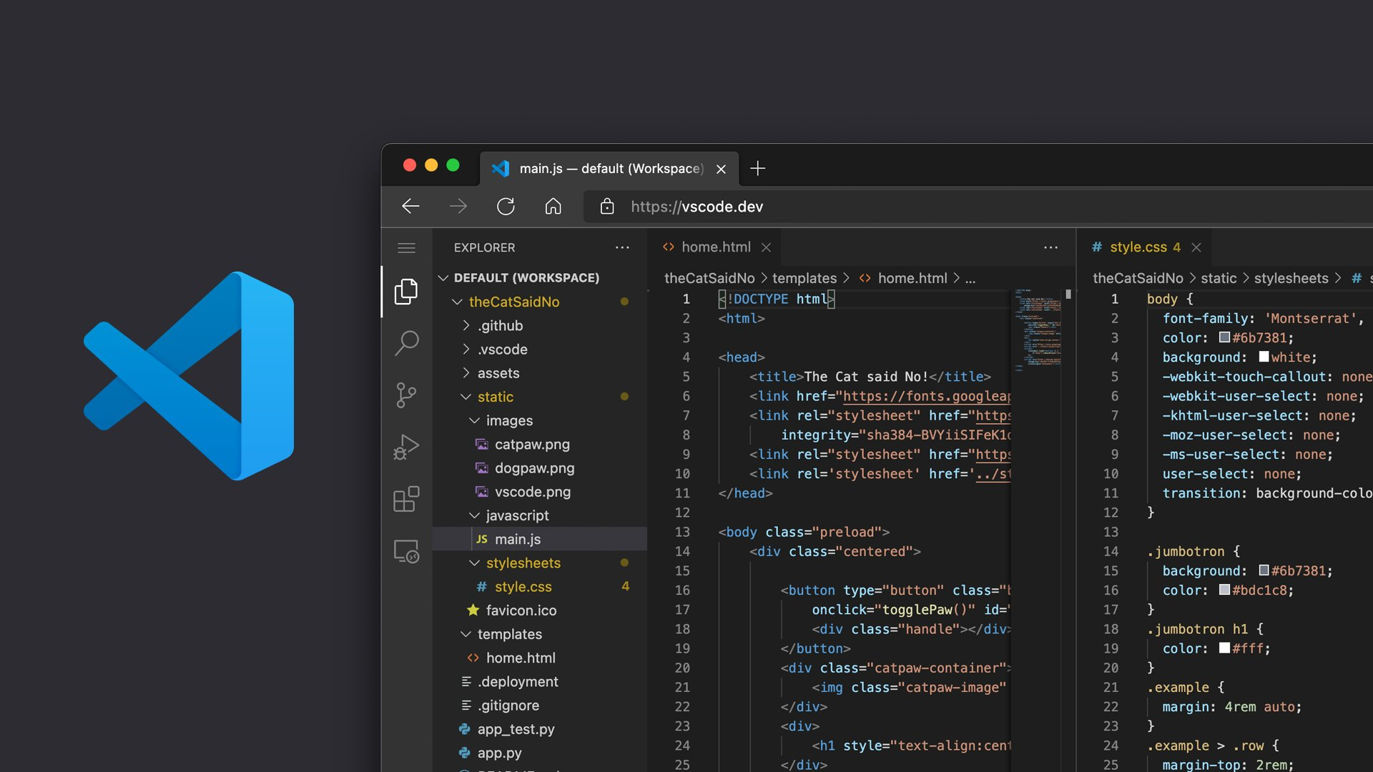


We need a Code Editor

Slide 11

HTML TIPS
01
<p> The File extension must be .html or .htm </p>
<p> MS-DOS and Windows 3.1,
had limitations on the number of characters in a filename. </p>
.EXE .TXT .DOC .BAT .COM .ZIP

Slide 12
HTML TIPS
02
<p> The file name must be the index.html
because it's a default path of our homepage
or the root of our website. </p>

Slide 13
HTML DOCUMENTS / STRUCTURE
<!DOCTYPE html>
<html>
<head>
<title> Home page </title>
</head>
<body>
<h1> Best HTML Course </hl>
</body>
</html>
Let the browser know it's an HTML5.
Appear once, at the top of the page
Root of an HTML Document
Contains the information about the HTML document
Title for the HTML page
Contains everything you want to display on the Web Page.
Defines a large heading

Slide 14


How browsers determine the language
of an HTML document?

Slide 15

The lang attribute specifies the
language of the element's content.
<html lang=“en”>
Specifies the language code
for the element's content
<html lang=“hi”> <html lang=“ko”> <html lang=“fr”>

Slide 16


02
HTML ATTRIBUTES
HTML ATTRIBUTES

Slide 17

The lang attribute
<html lang=“en”>
Specifies the language code
for the element's content
Attributes are used along with the HTML tags to define the characteristics of the element.
Attributes provide additional information about elements

Slide 18

HTML DOCUMENTS (in Hindi)
<!DOCTYPE html>
<html lang="hi">
<head>
<meta charset="UTF-8">
<title>Hindi Example</title>
</head>
<body>
<p> यह एक उदाहरण है कि हिंदी में कैसे लिखें </p>
</body>
</html>
We define the Lang Attribute to set Lang to Hindi
It’s simple instead of English write in Hindi

Slide 19

HTML Heading & Text
Headings (<h1> to <h6>)
Paragraphs (<p>)
Line breaks (<br>)
Horizontal rule (<hr>)

Slide 20
01
HTML HEADING
Content
Opening Tag
Closing Tag
<h1>
</h1>
Best HTML Course
HTML Elements

Slide 21

DID YOU KNOW?
h1: Typically, larger and bold, around 24px to 36px or even larger.
h2: Slightly smaller, around 18px to 30px.
h3: Smaller than h2, around 16px to 24px.
h4: Generally, around 14px to 20px.
h5: Smaller, often around 12px to 18px.
h6: The smallest, often around 10px to 16px.

Slide 22

01
HTML INTERVIEW
h1: Typically, larger and bold, around 24px to 36px or even larger.
h2: Slightly smaller, around 18px to 30px.
h3: Smaller than h2, around 16px to 24px.
h4: Generally, around 14px to 20px.
h5: Smaller, often around 12px to 18px.
h6: The smallest, often around 10px to 16px.

Slide 23

02
HTML PARAGRAPH TAG
Content
Opening Tag
Closing Tag
<p>
</p>
Best HTML Course
HTML Elements

Slide 24

DID YOU KNOW?
No matter how much whitespace you use inside HTML element content (which can include one or more space characters, but also line breaks), the HTML parser reduces each sequence of whitespace to a single space when rendering the code.

Slide 25

HTML Comment Tag
<!–– Comment Here -->
To comment out in HTML, insert information between <!-- and --> tags (browsers won't show these notes).
Commenting in HTML allows developers to leave notes about their code,
its functionality or to indicate necessary changes for the future.

Slide 26
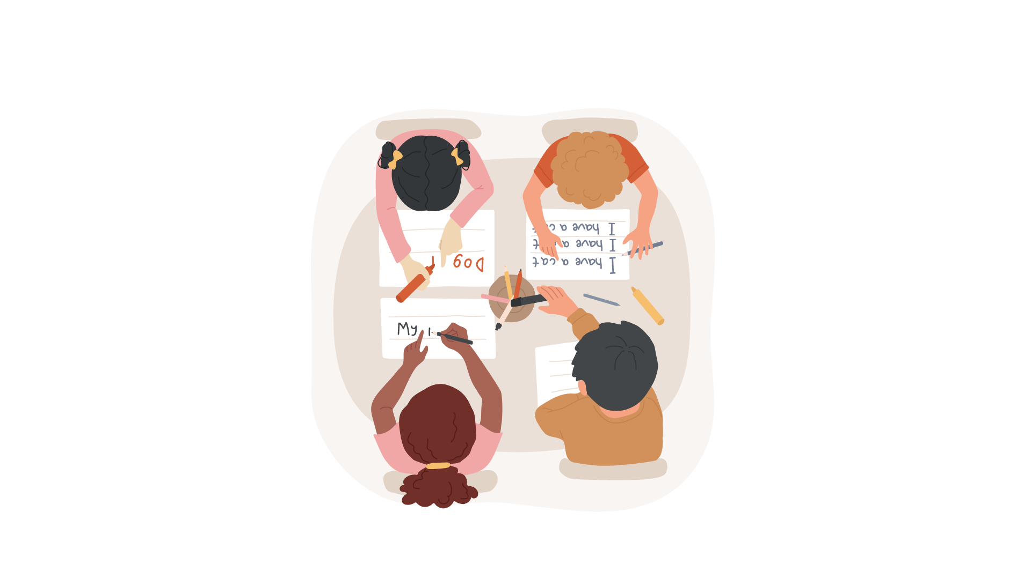
01
02
03
04
05
06
HTML Text Formatting
Bold and Italic:
<strong>, <em>
Underline and Strikethrough:
<u>, <s>
Subscript and Superscript:
<sub>, <sup>
Preformatted Text:
<pre>, <kbd>, <abbr>
Text Highlighting
<mark>, <small>, <del>
Inline Styles:
<p style="color:red" > </p>

Slide 27
HTML TIPS
03
While using nested tag in one
elements never mismatched the tags
❌ <p>My cat is <strong>very
grumpy.</p> </strong>
✅ <p>My cat is <strong>very</strong>
grumpy.</p>

Slide 28

HTML Anchor Tag
The <a> tag defines a hyperlink, which is used to link from one page to another.
Hypertext Reference
<a href="https://tt.com"> visit </a>
URL

Slide 29

HTML Entities
&lt;: Less than sign (<)
&gt;: Greater than sign (>)
&amp;: Ampersand (&amp;)
&quot;: Double quotation mark (")
&apos;: Single quotation mark or apostrophe (')
&nbsp;: Non-breaking space ( )
&dollar;: Dollar Sign ($)
&copy;: Copyright symbol (©)
&reg;: Registered trademark symbol (®)
&trade;: Trademark symbol (™)
&hearts;: Heart symbol (♥)

Slide 30

DID YOU KNOW?
We can represent the dollar sign symbol using 3 different
HTML entity methods
Using Named Entity: &dollar;
Using Hexadecimal Numeric Reference: #x00024;
Using Decimal Numeric Reference: &#36;

Slide 31

HTML Image Tag
The <img> tag is used to embed(ADD) an image in an HTML page.

Slide 32
HTML Image Tag
Specifies an alternate text for the
image, if the image for some reason
cannot be displayed
Specifies the path
to the image
<img src="/image.png“ alt=“altText”>
Relative URL

Slide 33
DID YOU KNOW?
Void Elements / Empty Elements
Not all parts of a web page use the usual pattern of having an opening tag, some content, and then a closing tag. Some parts only need a single tag to work. These are called "void elements” or “Empty Elements”.

Slide 34
HTML Empty Elements
<area>: Defines a clickable area within an image map.
<br> : Represents a line break.
<col> : Specifies column properties for a table column group.
<embed> : Embeds external content or plugin content.
<hr> : Represents a thematic break or horizontal rule.
<img> : Embeds an image.
<input> : Represents an input field.
<link> : Specifies relationships between a current document and external resources.
<meta> : Provides metadata about the HTML document.
<param> : Defines parameters for plugins.
<source> : Specifies multiple media resources for media elements like <audio> and <video>.
<track> : Specifies text tracks for media elements.
<wbr> : Represents a word break opportunity in text.

Slide 35

HTML Picture Tag
The <picture> HTML element contains zero or more
<source> elements and one <img> element to offer alternative versions of an image for different display/device scenarios.
<picture>
<source srcset="/thapa.webp">
<source srcset="/thapa.png">
<img src="/thapa.jpg“ alt=“”/>
</picture>

Slide 36

HTML Figure Tag
The <figure> HTML element represents self-contained content,potentially with an optional caption, which is specified using the <figcaption> element.
<figure>
<img src="/thapa.png“ alt=“”/>
<figcaption> Best HTML Course </figcaption>
</figure>

Slide 37

HTML Lists
Unordered Lists <ul>
An unordered list is used to create a list of items that are not in any particular order. Each list item is marked with a bullet point.
<ul>
<li> Apple </li>
<li> Orange </li>
<li> Banana </li>
</ul>
Ordered Lists <ol>
An ordered list is used to create a list of items in a specific order, typically indicated by numbers.
<ol>
<li> First item </li>
<li> Second item </li>
<li> Third item </li>
</ol>

Slide 38

DID YOU KNOW?
Unordered List (<ul>) Styles:
Disc (list-style-type: disc;): Default style - filled circles.
Circle (list-style-type: circle;): Hollow circles.
Square (list-style-type: square;): Squares.
None (list-style-type: none;): No bullet points.

Slide 39

DID YOU KNOW?
Ordered List (<ol>) Styles:
Decimal (list-style-type: decimal;) : Default style - decimal numbers.
Lowercase Letters (list-style-type: lower-alpha;) : Lowercase letters (a, b, c).
Uppercase Letters (list-style-type: upper-alpha;) : Uppercase letters (A, B, C).
Lowercase Roman Numerals (list-style-type: lower-roman;) : (i, ii, iii).
Uppercase Roman Numerals (list-style-type: upper-roman;) : (I, II, III).

Slide 40

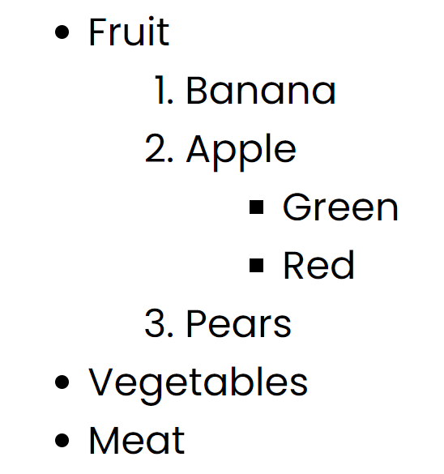
HTML LIST INTERVIEW
03
3: Explain the concept of nested lists.

Slide 41
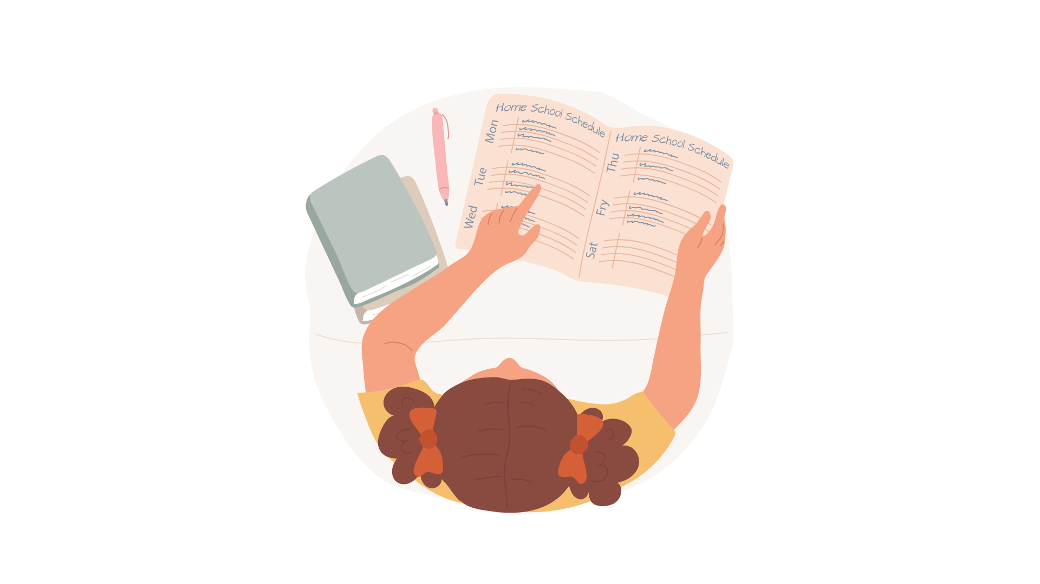
HTML Table Tag
HTML tables allow web developers to arrange data into rows and columns. We must write everything inside the table tag.
<table> Element: Defines an HTML table, which is used to organize
data into rows and columns.
<tbody> Element: Groups the main content (data rows) of an HTML table.
<thead> Element: Groups the header content (table headings) of an HTML table.
<th> Element: Defines a header cell (table heading) within a table.
<td> Element: Represents a data cell within an HTML table.
<tr> Element: Defines a row within an HTML table.

Slide 42
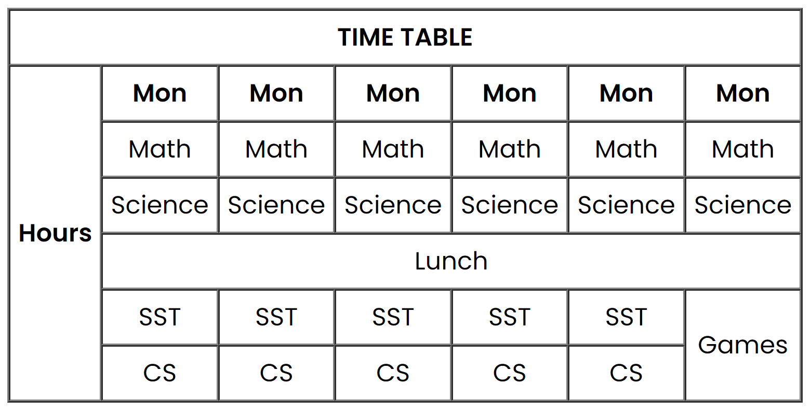
HTML TABLE INTERVIEW
01
Create a School TimeTable.

Slide 43

HTML iFrame Tag
The <iframe> HTML element represents a nested browsing context, embedding another HTML page into the current one.
The src attribute defines
the URL of the page to embed
<iframe src=“url” title="abc"></iframe>
For screen readers

Slide 44

HTML IFRAME INTERVIEW
01
1: How to create a nested webpage in HTML?
The HTML iframe tag is used to display a nested webpage. In simple, It represent a webpage within a webpage.

Slide 45

HTML Audio Tag
Audio (<audio>): The <audio> element is used to embed audio content in a webpage. It supports various audio formats and provides controls for playback.
attribute
<audio controls>
<source src="./audio/audio_thapa.mp3" type="audio/mpeg" />
<source src="./audio/audio_thapa.wav" type="audio/wav" />
Your browser does not support the audio element.
</audio>

Slide 46
DID YOU KNOW?
List of Attributes:
controls: Adds playback controls (play, pause, volume, etc.).
autoplay: Starts playback automatically.
loop: Repeats the media indefinitely.
preload: Specifies if the media should be loaded when the page loads.
poster: Displays an image before the media loads.

Slide 47
01
HTML AUDIO TAG INTERVIEW
1: Which are the attributes supported in audio tag?
controls: Adds playback controls (play, pause, volume, etc.).
autoplay: Starts playback automatically. loop: Repeats the media indefinitely.
poster: Displays an image before the media loads.
muted: Specifies that the audio output should be muted
loop: Specifies that the audio will start over again, every time it is finished

Slide 48
HTML Video Tag
The <video> HTML element embeds a media player which supports video playback into the document.
<video controls autoplay loop muted poster="./images/html.png">
<source src="./video/thapatech.mp4" type="video/mp4" />
<source src="./video/thapatech1.webm" type="video/webm" />
Your browser does not support the video element.
</video>

Slide 49

HTML Form Tag
The <form> tag is used to create an HTML form for user input.
The <input> HTML element is used to create interactive controls for web-based forms to accept data from the user. We must write inside the tag.

Slide 50
HTML Form Tag
attribute
<input type=“text“ name=“username”>
We have multiple values for the Type attribute.

Slide 51

HTML Semantic Elements
Semantic elements = elements with a meaning.
A semantic element clearly describes its meaning to both the browser and the developer.

Slide 52
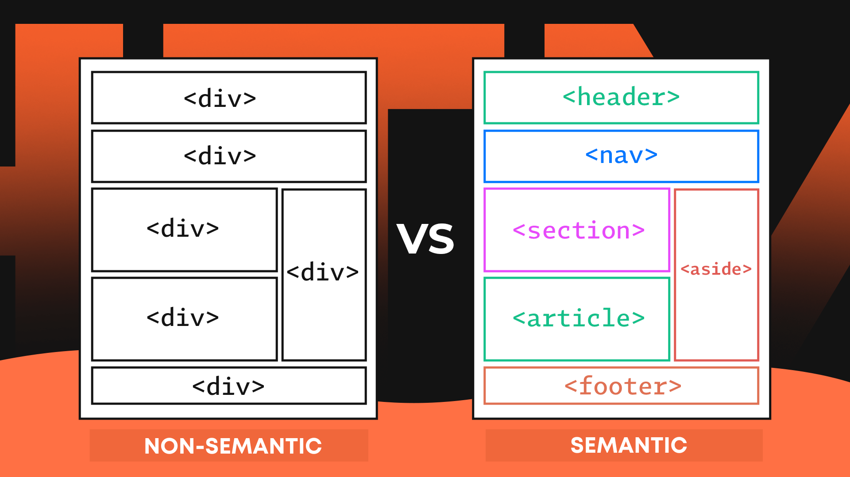
HTML Semantic Elements

Slide 53
HTML Semantic Elements
<header> — Represents the introductory content for a section, article, or entire web page. Ex. Contains Logo, site title etc.
<nav> — Navigation menu links would all be placed in a <nav> tag.
<main> — The body of a page should go in the <main> tag. There should be only one per page.
<article> — Represents an independent article on a web page. For example, a blog post.
<section> — Represent a way of grouping together nearby content of a similar theme.
<aside> — Represents the content that’s less important. It’s mostly used for sidebars (ads).
<footer> — Represent the base of a page or section. It might include contact information and some site navigation.

Slide 54
DID YOU KNOW?
Single <main> Tag: As a best practice, use only one <main> tag per HTML page. The <main> tag should encapsulate the primary content of your webpage, excluding headers, footers, and sidebars.
Use Headers Wisely: While you can use multiple <header> tags, make sure they're appropriately placed within semantic elements like <article>, <section>, or as introductory content for the whole page. Each <header> should provide relevant context.
Avoid Overuse: Use semantic elements purposefully and avoid overusing them. Choose elements that accurately represent your content's structure and hierarchy. Overusing them may lead to confusion and diluted semantics.

Slide 55
DID YOU KNOW?
Understand Nesting: Understand the hierarchy and nesting rules of semantic elements. For instance, <article> and <section> can contain <header>, <footer>, and other content, but nesting them should reflect logical relationships.
Enhance Accessibility: Semantic elements greatly improve web accessibility. Use them to create a clear structure for assistive technologies. Ensure that your content remains meaningful even if CSS or other styling is disabled.

Slide 56
HTML Meta Tags
Meta Tags for Metadata:
Meta tags are HTML elements that provide metadata about a webpage. They are placed within the <head> section of an HTML document and are not visible to users but are used by browsers, search engines, and other web services to gather information about the page

Slide 57
HTML Meta Tags
<meta name="viewport" content="width=device-width, initial-scale=1.0">:
Sets the viewport properties for responsive design.

Slide 58
HTML Meta Tags
<meta charset="UTF-8">: Specifies the character encoding for the webpage, ensuring proper rendering of characters.
<meta name="description" content="A brief description of the webpage">: Provides a concise description of the page's content.
<meta name="keywords" content="keyword1, keyword2, keyword3">: Specifies relevant keywords for search engines (not as impactful as it used to be).
<meta name="author" content="Author's Name">: Indicates the author of the webpage.

Slide 59

HTML Meta Tags
<meta name="robots" content="index, follow">: Instructs search engine robots whether to index and follow links on the page.

Slide 60


HTML SEO
High-Quality Content: Create valuable and relevant content that addresses users' needs.
Keyword Research: Use relevant keywords naturally within your content.
Descriptive Titles: Use descriptive and relevant titles for your pages (<title> tag).
Heading Tags: Use appropriate heading tags (<h1>, <h2>, etc.) to structure content.

Slide 61


HTML SEO
Image Alt Text: Provide descriptive alt text for images.
Internal Links: Use internal links to connect related content within your site.
External Links: Link to reputable external sources when relevant.
Mobile-Friendly Design: Ensure your website is responsive and mobile-friendly.
Site Speed: Optimize your website's loading speed for better user experience.

Slide 62
HTML FINAL PROJECT

Slide 63

HOST HTML WEBSITE LIVE

